Slide 1
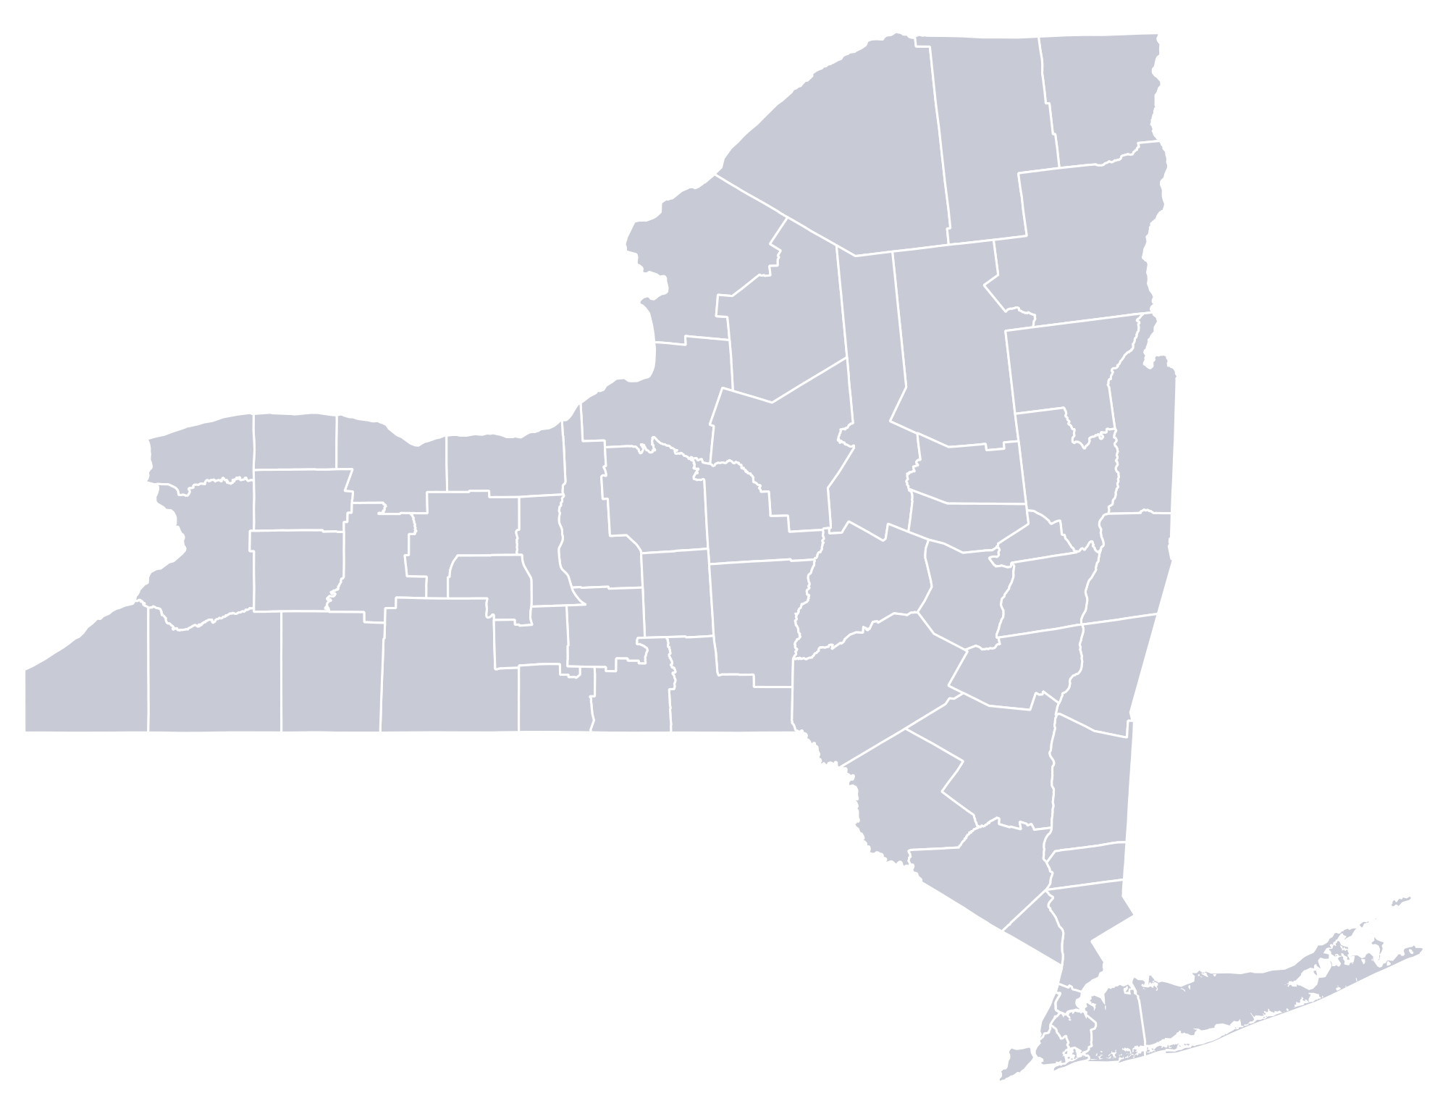
COMMUNITY SCORECARD
*Community Name*
Climate Smart Certification: *Level*
### points awarded
## completed actions
 | 1. Build a climate-smart community | ##
 | 2. Inventory emissions, set goals, and plan for climate actions | ##
 | 3. Decrease Energy Use | ##
 | 4. Shift to clean, renewable energy | ##
 | 5. Use climate-smart materials management | ##
 | 6. Implement climate –smart land use | ##
 | 7. Enhance community resilience to climate change | ##
 | 8. Support a green innovation economy | ##
 | 9. Inform and inspire the public | ##
 | 10. Engage in an evolving process of climate action | ##
 | 11. Innovation | ##
 | 12. Performance | ##
Document Created: *Month* 2021

