Slide 1
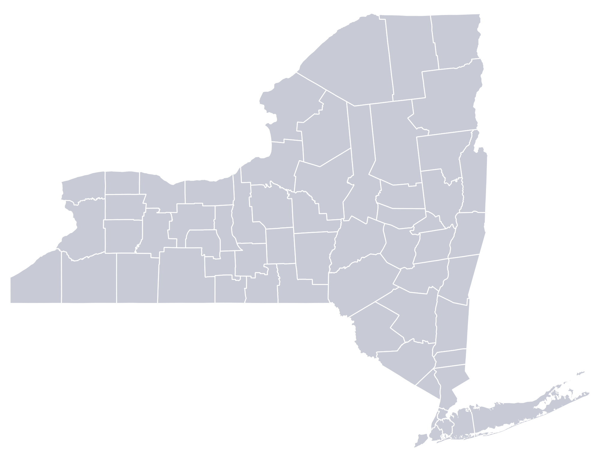
COMMUNITY SCORECARD
*Community Name*
 | Action (Action Type) | Possible Points | Approved
 | 1. Build a climate-smart community (# points)
 | CSC Task Force (Mandatory) | 20 | #
 | CSC Coordinator (Mandatory) | 10 | #
 | National/ Regional Climate Program | 3 | #
 | Partnership with Other Entities | 3 | #
 | 2. Inventory emissions, set goals, and plan for climate actions (# points)
 | Government Operations GHG Inventory (Priority) | 16 | #
 | Community GHG Inventory (Priority) | 16 | #
 | Government Operations Climate Action Plan (Priority) | 12,16 | #
 | Community Climate Action Plan (Priority) | 16 | #
 | 3. Decrease Energy Use (# points)
 | Government Building Energy Audits (Priority) | 8,10,12, 16 | #
 | Interior Lighting Upgrades | 1-5 | #
 | HVAC Upgrades | 1-5 | #
 | Water Efficient Fixtures | 1-4 | #
 | Building Energy Management System | 1-5 | #
 | Energy Benchmarking for Government Buildings | 2/4 | #
 | Clean Energy Upgrades | 10 | #
 | Green Building Standard for Government Buildings | 2,3,5 | #
 | Green Building Certification | 15 | #
 | Fleet Inventory | 4 | #
 | Fleet Efficiency Policy | 2-3 | #
 | Fleet Rightsizing | 1-3 | #
 | Advanced Vehicles | 2,4,6,8,10 | #
 | LED Street Lights | 5,6,7,8,10 | #
 | LED Traffic Signals | 1-4 | #
 | Outdoor Lighting Reduction | 1,3,4 | #
 | Outdoor Lighting Upgrades | 1-4 | #
 | Environmentally Preferable Purchasing Policy | 1-4 | #
 | Financing Mechanism for Govt. Energy Projects | 5 | #
 | Waste & Energy Provisions in Govt. Contracts | 1-3 | #
 | Incentives for Employee Carpooling and Transit | 1-3 | #
 | Energy Code Enforcement Training | 5 | #
 | 4. Shift to clean, renewable energy (# points)
 | Green Power Procurement Policy | 2,4 | #
 | Renewable Energy Feasibility Studies | 3,4,5 | #
 | Renewable Energy Certificates | 2,5,12 | #
 | Geothermal Installation | 9,14,17, 19,20 | #
 | Solar Energy Installation | 9,14,17, 20 | #
 | Power Purchase Agreement for Renewables | 9,14,17, 19,20 | #
 | Wind Energy Installation | 9,14,17, 20 | #
 | Wood Pellet installation | 6,11,14, 16,17 | #
 | 5. Use climate-smart materials management (# points)
 | Organics Management Plan | 2-16 | #
 | Government Solid Waste Audit | 2 | #
 | Recycling Bins in Government Buildings | 3 | #
 | Organic Waste Program for Government Buildings | 1-3 | #
 | WasteWise Program | 1-2 | #
 | Construction and Demolition Waste Policy | 2,4,6 | #
 | Resource Recovery Center | 6 | #
 | Recycling Program for Public Places and Events | 1-3 | #
 | Waste Reduction Education Campaign | 2 | #
 | Community Repair | 4 | #
 | Compost Bins for Residents | 2 | #
 | Residential Organic Waste Program | 2-22 | #
 | Action (Action Type) | Possible Points | Approved
 | 6. Implement climate-smart land use (# points)
 | Comprehensive Plan with Sustainability Elements (Priority) | 3-21 | #
 | Incorporate Smart Growth Principles into Land-use Policies and Regulations | 1-8 | #
 | Unified Solar Permit | 5 | #
 | Establish Green Building Codes | 1-6 | #
 | Adopt Land-use Policies to Support Local Agriculture | 1-4 | #
 | GreenLITES | 6,9,12,15 | #
 | Adopt Green Parking Lot Standards | 1-4 | #
 | Complete Streets Policy (Priority) | 4 | #
 | Planning & Infrastructure for Bicycling & Walking | 2-15 | #
 | Alternative-fuel Infrastructure (Priority) | 4-18 | #
 | Strategies that Increase Public Transit Ridership | 1-9 | #
 | Implement a Safe Routes to School Program | 3 | #
 | Traffic Calming | 3-10 | #
 | Adopt and Enforce an Anti-idling Ordinance | 1,3 | #
 | Natural Resources Inventory (Priority) | 8,10 | #
 | Develop a Local Forestry or Tree Planting Program | 1-10 | #
 | Preserve Natural Areas Through Zoning | 4,6 | #
 | 7. Enhance community resilience to climate change (# points)
 | Climate Vulnerability Assessment (Priority) | 4,8,16 | #
 | Evaluate Policies for Climate Resilience (Priority) | 6 | #
 | Climate Adaptation Plan (Priority) | 3,8,11 | #
 | Hazard Mitigation Plan | 4 | #
 | Heat Emergency Plan | 6 | #
 | Shade Structures Policy | 4 | #
 | Cooling Centers | 1-9 | #
 | Conserve Natural Areas | 1-21 | #
 | Watershed-based Flood Mitigation Plan | 2,5 | #
 | Design Flood Elevation & Flood Maps | 2-14 | #
 | Freeboard Policies | 4-19 | #
 | Green Infrastructure | 1-14 | #
 | Culverts and Dams | 2-24 | #
 | Riparian Buffers | 2-14 | #
 | Strategic Relocation | 4,7,8,11 | #
 | Nature-based Shorelines | 2,4,8,10, 12 | #
 | NFIP Community Rating System | 3,5,7,9 | #
 | Watershed Plan for Water Quality | 2,4,6 | #
 | Source Water Protection | 6,10 | #
 | Water Conservation & Reuse | 2,4,6 | #
 | Water-smart Landscaping | 1-9 | #
 | 8. Support a green innovation economy (# points)
 | Green Jobs Training | 3 | #
 | Green Vendor Fairs | 2 | #
 | Green Economic Development Plans | 4 | #
 | Farmers’ Markets | 3 | #
 | Buy Local/ Buy Green Campaign | 2 | #
 | Brownfield Clean-up & Redevelopment | 1-18 | #
 | Incentives for Green Businesses | 4 | #
 | Energy Benchmarking for Private Buildings | 4,10 | #
 | Financing Program for Building Energy Efficiency | 2,7 | #
 | Community Choice Aggregation | 15,18,21 | #
 | Solarize, Clean Heating & Colling/ Solar for All | 5 | #
 | 9. Inform and inspire the public (# points)
 | Climate Change Education and Engagement (Priority) | 4.8 | #
 | Energy Reduction Campaign | 5 | #
 | Climate-related Public Events | 3 | #
 | Local Climate Action Website | 3 | #
 | Social Media | 3 | #
 | 10. Engage in an evolving process of climate action (# points)
 | GHG Tracking System | 5 | #
 | Annual Progress Report | 4 | #
 | Updates to Strategies and Plans | 4 | #
 | 11. Innovation (# points)
 | New Innovative Actions | 3-18 | #
 | Innovative Approaches to Existing CSC Actions | 5,10 | #
 | 12. Performance (# points)
 | Reduce GHGs from Government Facilities | 15-45 | #
 | Reduce GHGs from government Vehicles | 15-45 | #
 | Reduce Solid Waste From Government Operations | 3,4,6,8,10 | #
Certification: *Level*
### points approved
## completed actions
TOTAL POINTS
300
SILVER
BRONZE
120
PLEDGE ELEMENTS ##
MANDATORY ACTIONS ##/2
PRIORITY ACTIONS ##
PL: Planned Actions
Document Created: *Month* 2021

Slide 2
COMMUNITY SCORECARD
Saranac Lake
Action (Action Type) | Possible Points | Approved
1. Build a climate-smart community (# Points)
CSC Task Force (Mandatory) | 20 | 20
CSC Coordinator (Mandatory) | 20 | 20
National/ Regional Climate Program | 3 | 3
Partnership with Other Entities | 3 | 3
2. Inventory emissions, set goals, and plan for climate actions (# points)
Government Operations GHG Inventory (Priority) | 16 | 16
3. Decrease Energy Use (# points)
Interior Lighting Upgrades | 1-5 | 5
HVAC Upgrades | 1-5 | 5
Energy Benchmarking for Government Buildings | 2/4 | 4
Fleet Inventory | 4 | 4
Energy Code Enforcement Training | 5 | 5
5. Use climate-smart materials management (# points)
Residential Organic Waste Program | 2-22 | 15
Action (Action Type) | Possible Points | Approved
6. Implement climate-smart land use (# points)
Incorporate Smart Growth Principles into Land-use Policies and Regulations | 1-8 | 5
Unified Solar Permit | 5 | 5
Complete Streets Policy (Priority) | 4 | 4
Planning & Infrastructure for Bicycling & Walking | 2-15 | 10
Alternative-fuel Infrastructure (Priority) | 4-18 | 10
Implement a Safe Routes to School Program | 3 | 3
Develop a Local Forestry or Tree Planting Program | 1-10 | 5
8. Support a green innovation economy (# points)
Farmers’ Markets | 3 | 3
9. Inform and inspire the public (# points)
Climate-related Public Events | 3 | 3
Local Climate Action Website | 3 | 3
Social Media | 3 | 3
Certification: Bronze
125 points earned
22 completed actions
TOTAL POINTS
300
SILVER
BRONZE
120
PLEDGE ELEMENTS 7
MANDATORY ACTIONS 2/2
PRIORITY ACTIONS 3
PL: Planned Actions
Document Created: February 2021

Slide 3
COMMUNITY SCORECARD
Example County
Action (Action Type) | Possible Points | Approved
1. Build a climate-smart community (# Points)
CSC Task Force (Mandatory) | 20 | 20
CSC Coordinator (Mandatory) | 20 | 20
National/ Regional Climate Program | 3 | 3
Partnership with Other Entities | 3 | 3
2. Inventory emissions, set goals, and plan for climate actions (# points)
Government Operations GHG Inventory (Priority) | 16 | 16
Community GHG Inventory (Priority) | 16 | 16
Government Operations Climate Action Plan (Priority) | 12,16 | 12
Community Climate Action Plan (Priority) | 16 | 16
3. Decrease Energy Use (# points)
Government Building Energy Audits (Priority) | 16 | 10
Interior Lighting Upgrades | 1-5 | PL
HVAC Upgrades | 1-5 | PL
Water Efficient Fixtures | 1-4 | 4
Incentives for Employee Carpooling and Transit | 1-3 | 2
Energy Code Enforcement Training | 5 | PL
4. Shift to clean, renewable energy (# points)
Green Power Procurement Policy | 2,4 | PL
Renewable Energy Feasibility Studies | 3,4,5 | PL
Renewable Energy Certificates | 2,5,12 | 12
Wind Energy Installation | 20 | PL
Wood Pellet installation | 17 | 14
5. Use climate-smart materials management (# points)
Organics Management Plan | 2-16 | 16
Government Solid Waste Audit | 2 | 2
Recycling Bins in Government Buildings | 3 | PL
Organic Waste Program for Government Buildings | 1-3 | 2
Community Repair | 4 | 4
Compost Bins for Residents | 2 | 2
Residential Organic Waste Program | 2-22 | 20
Action (Action Type) | Possible Points | Approved
6. Implement climate-smart land use (# points)
Comprehensive Plan with Sustainability Elements (Priority) | 3-21 | 20
Incorporate Smart Growth Principles into Land-use Policies and Regulations | 1-8 | 5
Preserve Natural Areas Through Zoning | 4,6 | 6
7. Enhance community resilience to climate change (# points)
Climate Vulnerability Assessment (Priority) | 4,8,16 | PL
Heat Emergency Plan | 6 | PL
Water-smart Landscaping | 1-9 | 5
8. Support a green innovation economy (# points)
Green Jobs Training | 3 | PL
Green Vendor Fairs | 2 | 2
Green Economic Development Plans | 4 | 4
Solarize, Clean Heating & Colling/ Solar for All | 5 | 5
9. Inform and inspire the public (# points)
Climate Change Education and Engagement (Priority) | 4.8 | 8
Energy Reduction Campaign | 5 | 5
Social Media | 3 | 3
10. Engage in an evolving process of climate action (# points)
GHG Tracking System | 5 | 5
Annual Progress Report | 4 | 4
Updates to Strategies and Plans | 4 | 4
11. Innovation (# points)
New Innovative Actions | 3-18 | 10
Innovative Approaches to Existing CSC Actions | 5,10 | 10
12. Performance (# points)
Reduce GHGs from Government Facilities | 15-45 | PL
Certification: Silver
290 points earned
32 completed actions
TOTAL POINTS
300
SILVER
BRONZE
120
PLEDGE ELEMENTS 12
MANDATORY ACTIONS 2/2
PRIORITY ACTIONS 7
PL: Planned Actions
Document Created: *Month* 2021

